Slide 1






Enhancing societal relevance through research, innovation, and educational excellence.
As Serbia's first national research institute of significance, IPB leads in international collaboration, researcher mobility, and participation in competitive projects.
Its mandate encompasses fundamental science, interdisciplinary collaboration, technology transfer, and maintaining essential national services and infrastructure.
IPB has been instrumental in Serbia's entry into CERN, hosting the Serbia-CERN Industrial Liaison Office
and participating in multiple CERN collaborations, including ATLAS and SHIP.
Contact
(381) 11 37 13 140
(381) 11 37 13 000
Pregrevica 118
11080 Zemun, Beograd
SERBIA
info@ipb.ac.rs
https://www.ipb.ac.rs/
Institute of Physics Belgrade
Your Horizon Europe partner in:
Scientific research projects
Innovation projects
Research & Innovation boosting support projects

Slide 2





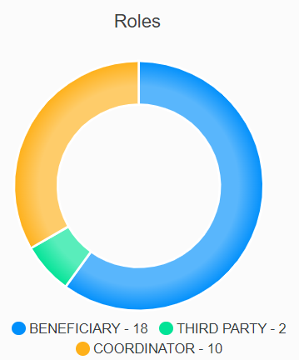


Institute of Physics Belgrade
10 ACTIVE HE PROJECTS
4 EU Centers of Excellence
22 Laboratories
Multi-sectoral environment
14 FP7 projects
Widening Twinning
8 Horizon 2020 projects
8 Horizon Europe projects
CERN member
EOSC network member
Host of the COST coordinator for Serbia
125 senior researchers
75 doctoral students
extensive administrative and technical staff
Host of two ERC projects
out of three total in Serbia

